Slide 1
CAPSTONE PROJECT
Movie ticket booking
Presented By:
1. S.Dharchana –Alagappa college of technology , anna university- textile technology

Slide 2
OUTLINE
Problem Statement
Proposed System/Solution
System Development Approach
Algorithm & Deployment
Result
Conclusion
Future Scope
References

Slide 3
PROBLEM STATEMENT
Movie ticket booking to simplify the ticket buying process

Slide 4
PROPOSED SOLUTION
Develop a Python program that allows users to browse available movies, select showtimes, choose seats, and make bookings for movie tickets. The program should handle
user authentication
seat availability checks
payment processing
confirmation of bookings.
Additionally, it should provide a user-friendly interface for easy navigation and a seamless booking experience.

Slide 5
SYSTEM APPROACH
Requirement Analysis:
Understand the requirements of the ticket booking system, including user needs, functionality, security, scalability, and performance expectations.
2. System Design: Design the system architecture, database schema, user interface, and integration with external services. Determine the technology stack, frameworks, and libraries to be used.
3.Database Design: Create a database structure to store movie, theater, showtime, seat, user, booking, payment, and other relevant data. Define relationships, constraints, and indexing for efficient data retrieval.
4.User Interface Design:
Design user interfaces for browsing movies, selecting showtimes, choosing seats, managing bookings, and making payments. Ensure a user-friendly and intuitive experience.
5.Backend Development:
Develop backend logic for user authentication, seat availability checks, booking management, payment processing, and email notifications. Implement business rules and algorithms.

Slide 6
6.Integration:
Integrate external services like payment gateways for secure online transactions. Implement APIs or SDKs for seamless communication with external systems.
7.Testing:
Conduct thorough testing, including unit testing, integration testing, system testing, and acceptance testing. Test various scenarios, edge cases, and error handling to ensure system reliability and correctness.
8.Deployment:
Deploy the application on a suitable hosting environment, configure server settings, database connections, and application settings. Ensure scalability, availability, and security of the deployed system.
9.Maintenance and Support:
Provide ongoing maintenance, updates, and support for the ticket booking system. Monitor system performance, address user feedback, fix bugs, and enhance features as needed.

Slide 7
ALGORITHM & DEPLOYMENT
Algorithm for Movie Ticket Booking Program:
User Authentication:
Validate user credentials (username and password).
Grant access to authenticated users.
2. Browse Movies:
Display a list of available movies with details (title, genre, rating, etc.).
Allow users to select a movie of their choice.
3.Select Showtimes:
Show available showtimes for the selected movie.
Let users choose a preferred showtime.
4.Choose Seats:
Display a seating layout for the selected showtime.
Enable users to select seats based on availability.
5.Make Booking:
Collect user information (name, contact details, etc.).
Validate booking details (movie, showtime, seats, etc.).
Confirm the booking and update seat availability.

Slide 8
6. Payment Processing:
Calculate the total booking amount based on selected seats.
Integrate with a payment gateway for secure online payments.
Process the payment and generate a booking confirmation.
7.Confirmation and Notification:
Display a booking confirmation with details (booking ID, seats, amount, etc.). Send an email or SMS confirmation to the user's registered contact.
Deployment Process:
Environment Setup:
Set up a development environment with Python installed.
Install necessary libraries and dependencies (e.g., Flask/Django for web development, SQLAlchemy for database access, etc.).
2.Database Configuration:
Choose a database system (e.g., MySQL, PostgreSQL) and configure database settings.
Create database tables for storing movie, theater, showtime, seat, user, booking, and payment information.
3.Backend Development:
Develop backend logic for user authentication, movie browsing, showtime selection, seat booking, payment processing, etc.
Implement business rules and algorithms using Python.
4.Frontend Development: - Design user interfaces for the ticket booking system using HTML, CSS, and JavaScript. Use frameworks like Flask/Django templates or frontend libraries (e.g., React, Vue.js) for interactive UI components.

Slide 9
5.Integration and Testing:
Integrate external services like payment gateways and email/SMS providers.
Conduct thorough testing (unit tests, integration tests, system tests) to ensure functionality, security, and performance.
6.Deployment:
Choose a deployment platform (e.g., Heroku, AWS, DigitalOcean) for hosting the application.
Configure server settings, domain mapping, SSL certificates, etc.
Deploy the application and monitor for any issues or errors.
7.Maintenance and Updates:
Provide ongoing maintenance, updates, and support for the deployed system.
Monitor system performance, handle user feedback, fix bugs, and implement new features as needed.

Slide 10
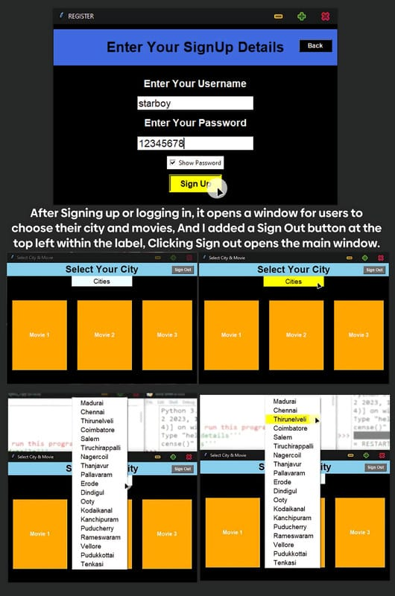
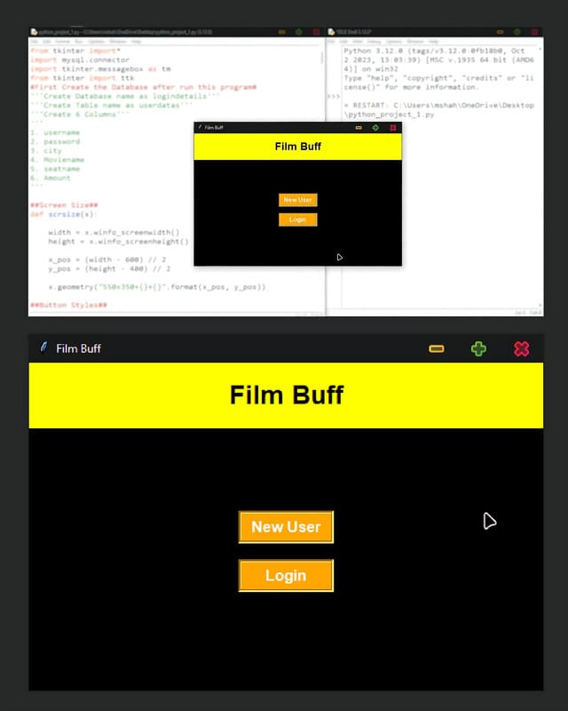
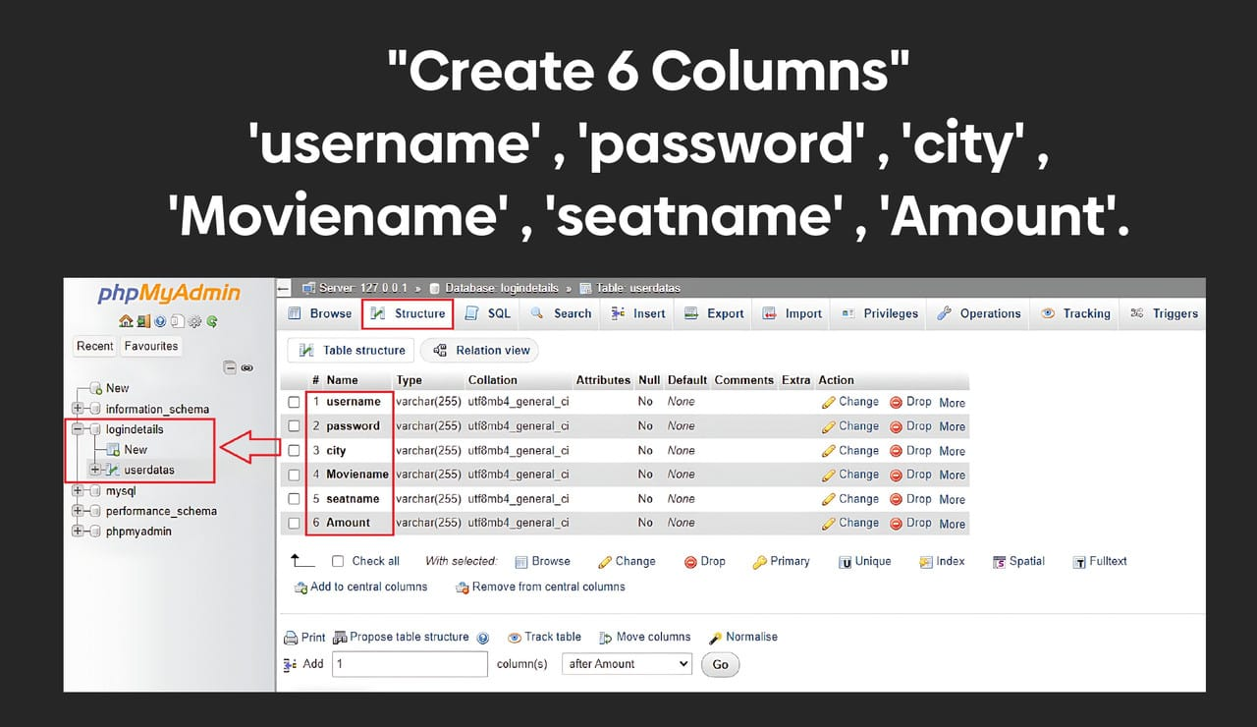
RESULT

Slide 11
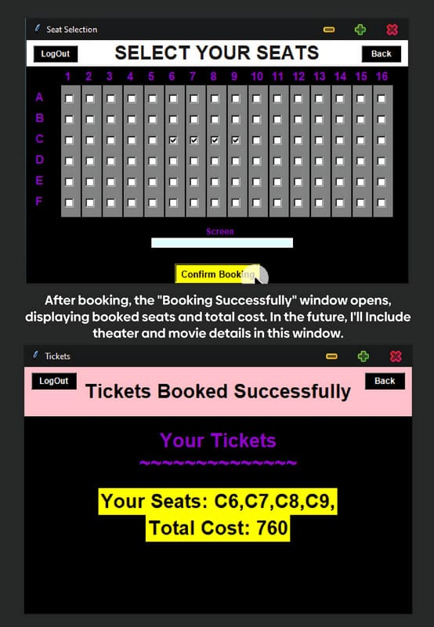
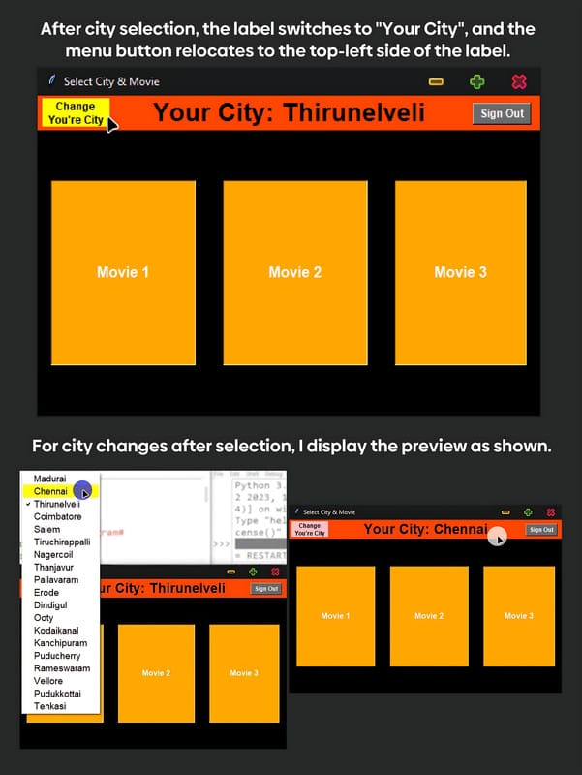
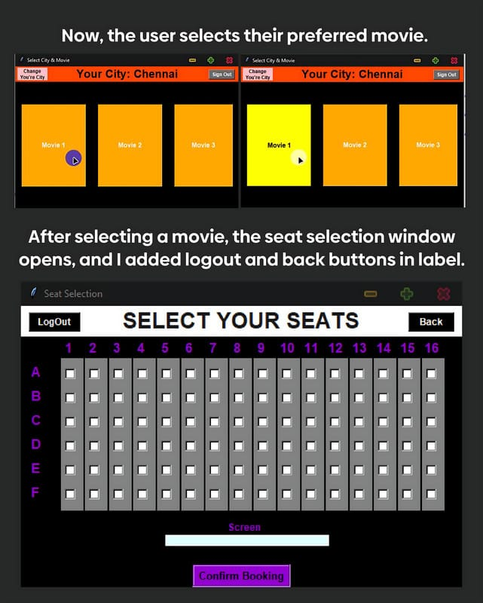

Slide 12
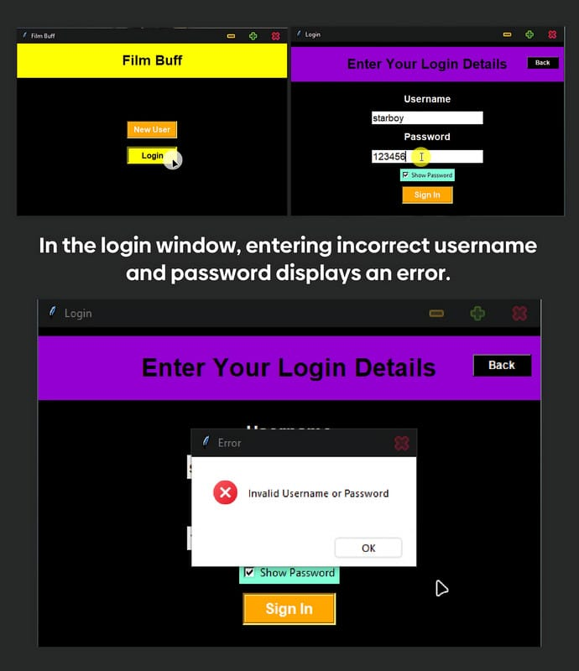
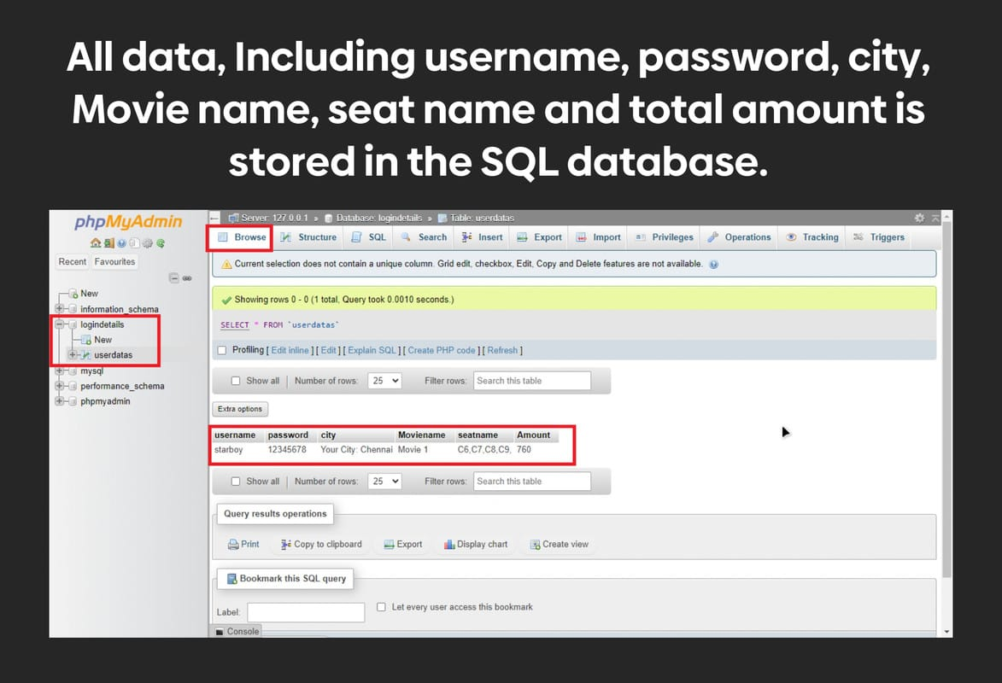

Slide 13
CONCLUSION
The bus ticket booking system developed in Python provides a comprehensive solution for users to book tickets for bus services efficiently and securely. The system offers a range of features such as user registration, bus route management, ticket booking, seat selection, payment integration, cancellation options, and admin functionalities.By implementing robust error handling, validation mechanisms, and security measures, the system ensures data integrity, user privacy, and protection against unauthorized access. The integration of a payment gateway facilitates seamless and secure online transactions, enhancing user convenience and trust in the booking process.The admin panel enables efficient management of bus routes, schedules, seat availability, user bookings, and cancellations, with access to insightful reports and analytics for informed decision-making. Overall, the bus ticket booking system in Python aims to provide a user-friendly interface, reliable functionality, and a satisfying booking experience for both users and administrators alike.

Slide 14
FUTURE SCOPE
1.Mobile Application Development:
Developing a dedicated mobile application for Android and iOS platforms can significantly expand the user base and provide on-the-go booking convenience.
2.Personalized Recommendations: Implementing machine learning algorithms to analyze user preferences and behavior can enable personalized movie recommendations, enhancing user engagement and satisfaction.
3.Social Media Integration:
Integrating social media platforms for user authentication, sharing movie experiences, and providing referral incentives can increase user interaction and promote viral marketing.
4.Real-time Seat Availability:
Implementing real-time updates for seat availability and interactive seat maps can improve booking accuracy and user experience.
5.Dynamic Pricing:
Introducing dynamic pricing strategies based on factors such as demand, time of booking, seat selection, and movie popularity can optimize revenue and incentivize early bookings.

Slide 15
THANK YOU

